Slide 1
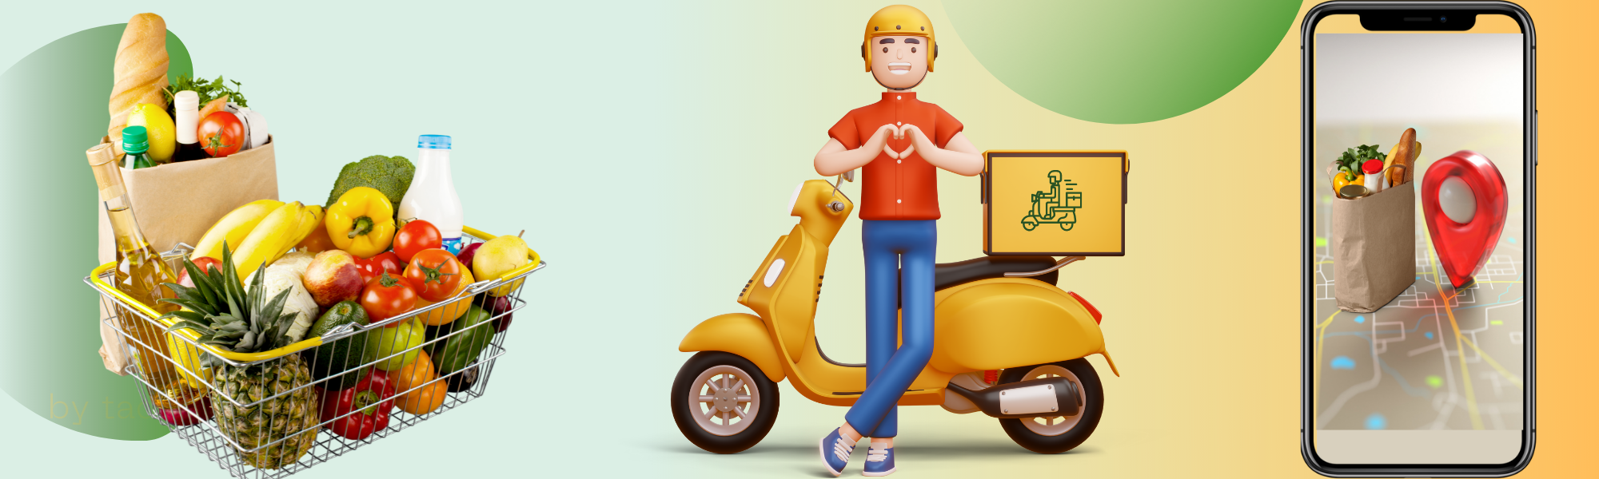
Grocery Delivery Application
By-Shreya D Chandak

Slide 2
Agenda
What is a Grocery Delivery application
Features
Workflow
Technologies used
UML Diagrams
Table Schemas
Working of application
Conclusion

Slide 3
What is Grocery Delivery Application?
Grocery shopping delivery app allows users to get all their grocery needs delivered to their doorstep without any inconvenience.
One can easily get their favorite grocery products delivered with just a few simple clicks.
Whether you want to get your chocolate syrup or your cornflakes delivered, everything is possible with this single powerful webapp.

Slide 4
Features
Easy Customer Registration: The system allows the customers to register themselves with the application in a simple and hassle-free way by providing just a few details.
Grocery Search: The application allows customers to search for groceries by category, brand, and product name.
Shopping Cart: The system allows the customers to add products to their shopping cart, edit their carts and place them for checkout.
Payment: The system allows customers to make payments for their orders through various payment options such as credit/debit cards, UPI, and cash on delivery
Order Tracking: The system allows the customers to track the status of their orders using tracking Id.
Feedback: The system allows the customers to rate and review the services and products based on experience and quality.
Order History: The system maintains the record of customer order history for reference and future orders.

Slide 5
Workflow
Make registration on the app by providing your email address, phone number, and a few other details.
Choose the grocery items that you want to get delivered to your doorstep.
Add to cart
Confirm your payment option. It can be cash on delivery, debit card, credit card, or UPI.
Place your Order.
Within a few hours, a professional delivery agent will reach your place.
In the end, provide your reviews and feedback on your experience.

Slide 6
Concept of Roles:
We know in real time there are several people using the application for different purposes.
In this application too, I have tried to use the same concept by defining the roles. Although, In real time it requires a high level of authentication and security.
There are three roles a user can have:
1. ADMIN- To manage the processes from the seller’s point of view.
2. USER – The user is not registered with the application but still can avail
of some services such as viewing the products.
3. CUSTOMER- The user is registered with the application and can avail of a wide
range of services from viewing to placing the order to giving
feedback on the order.

Slide 7
Technologies used
Spring framework
Dependencies: Spring Web, MySql Driver, SpringData JPA, Validation,
Lombok
Database used: MySql

Slide 8
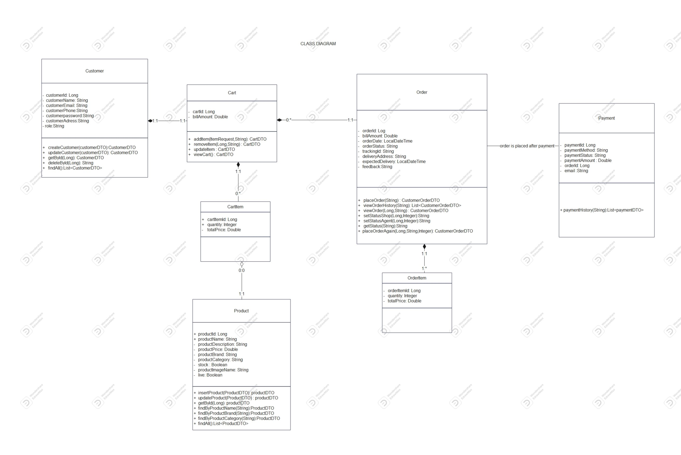
UML Diagrams(Class Diagram)

Slide 9
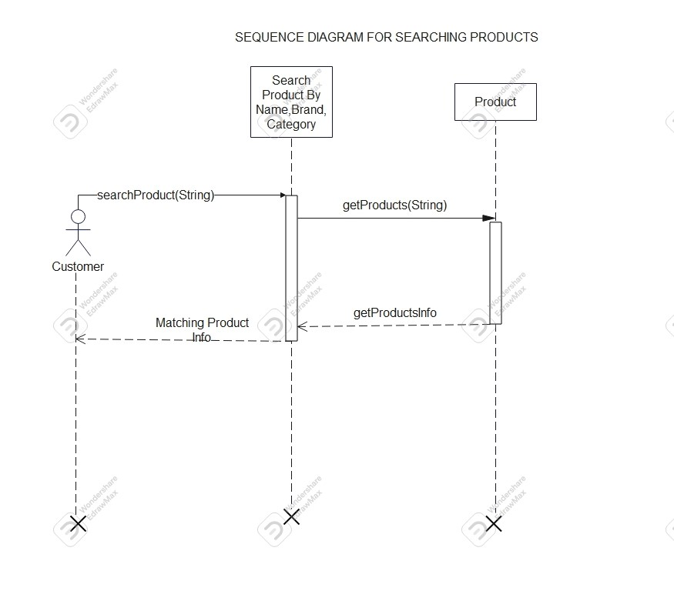
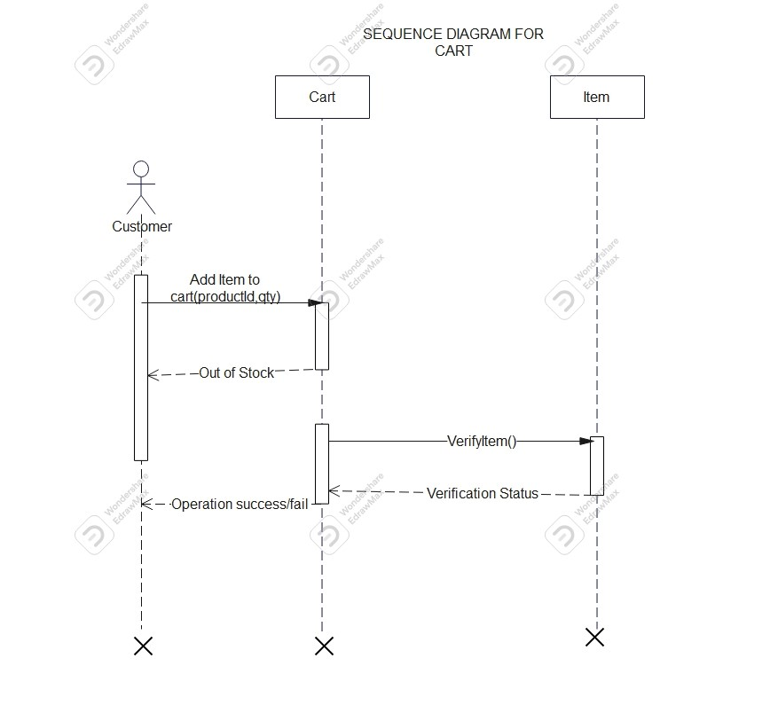
UML Diagrams(Sequence Diagrams)

Slide 10
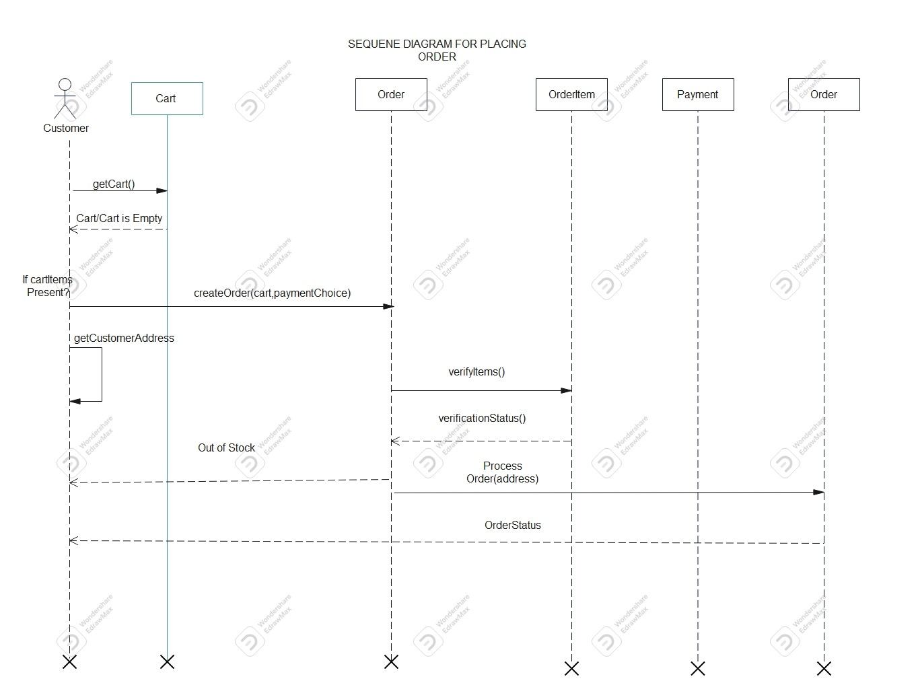
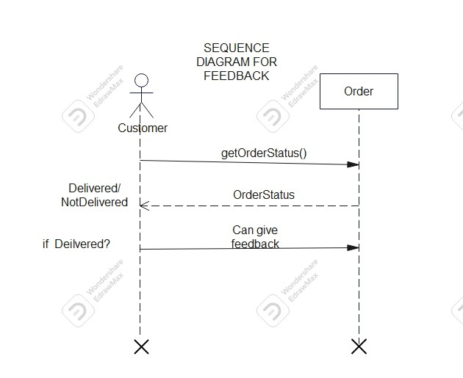
UML Diagrams(Sequence Diagrams)

Slide 11
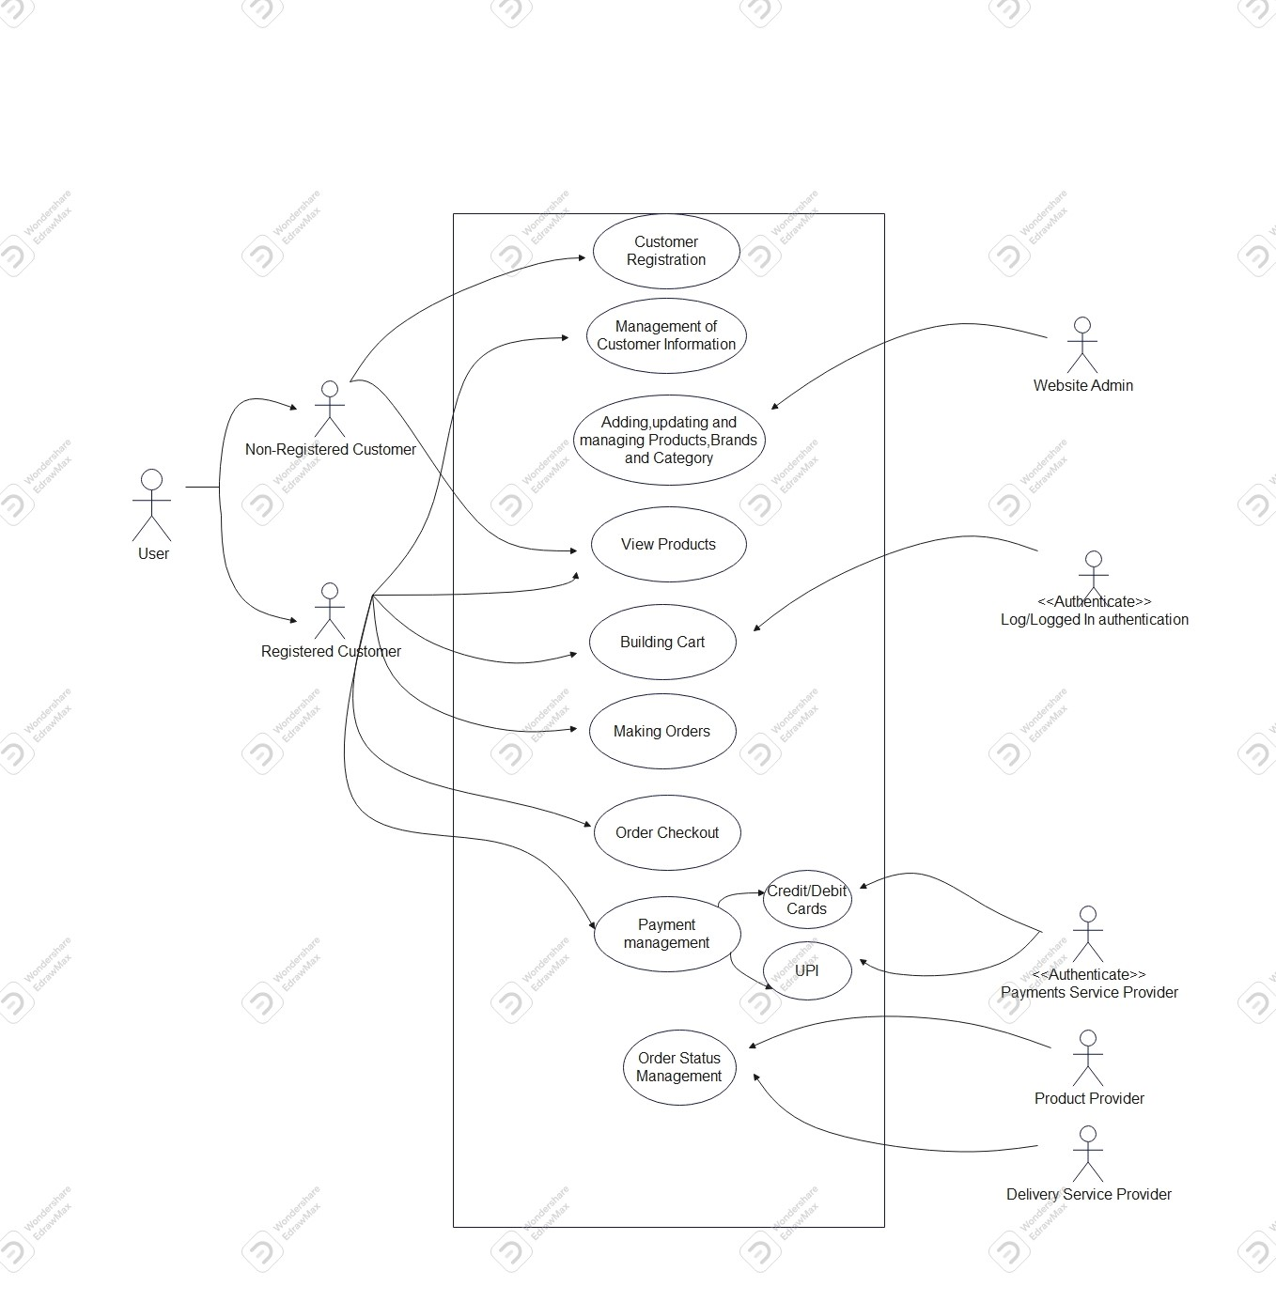
UML Diagrams(Use Case Diagram)

Slide 12
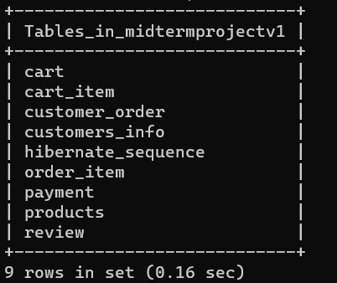
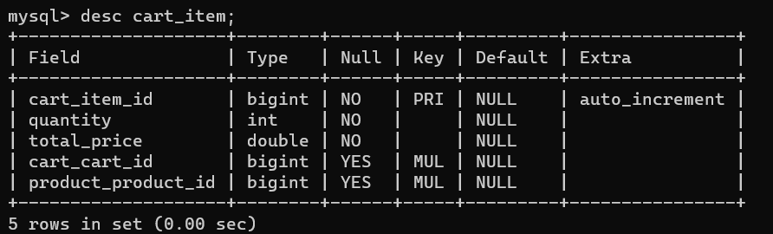
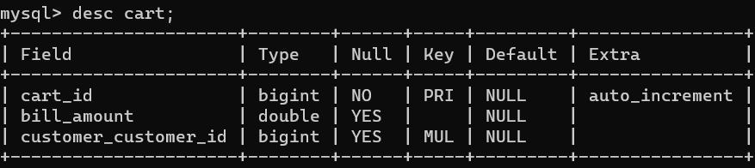
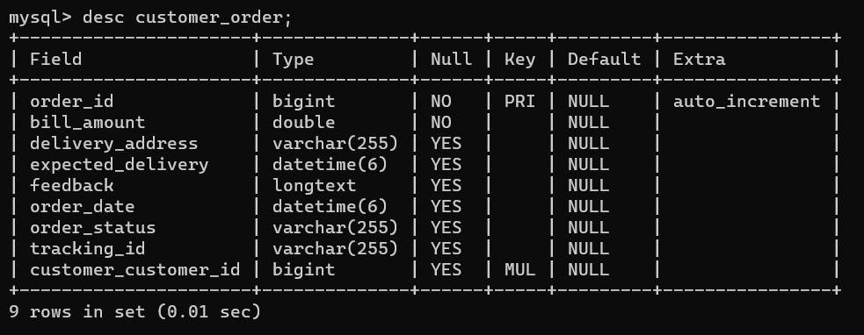
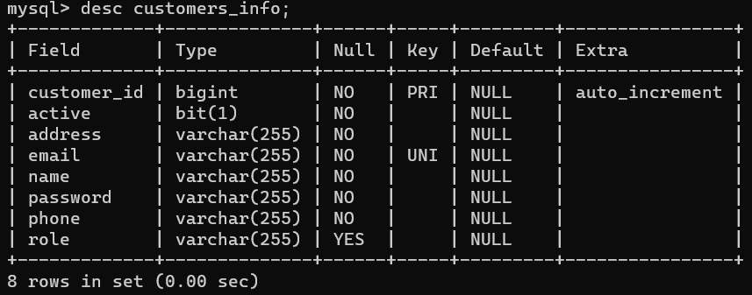
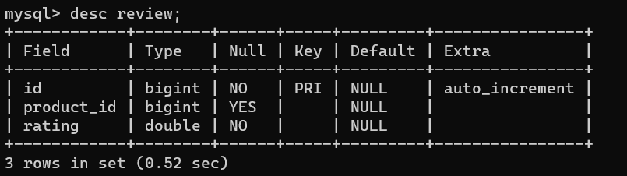
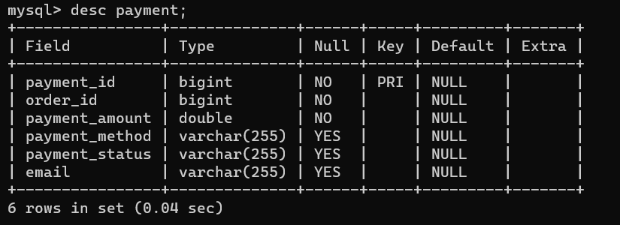
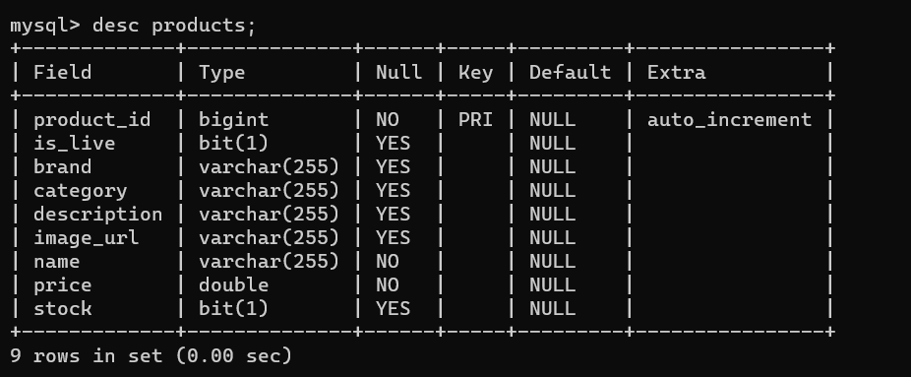
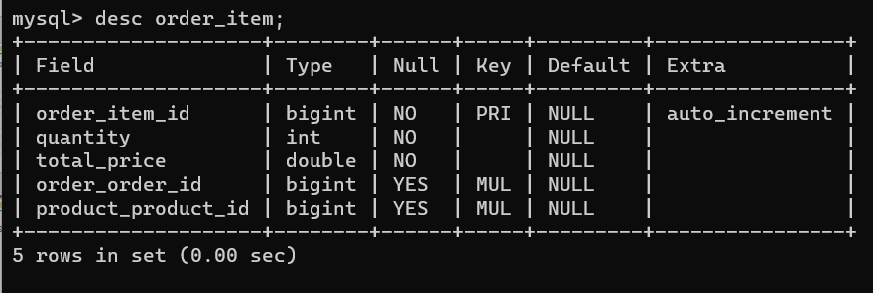
Tables in Database.

Slide 13
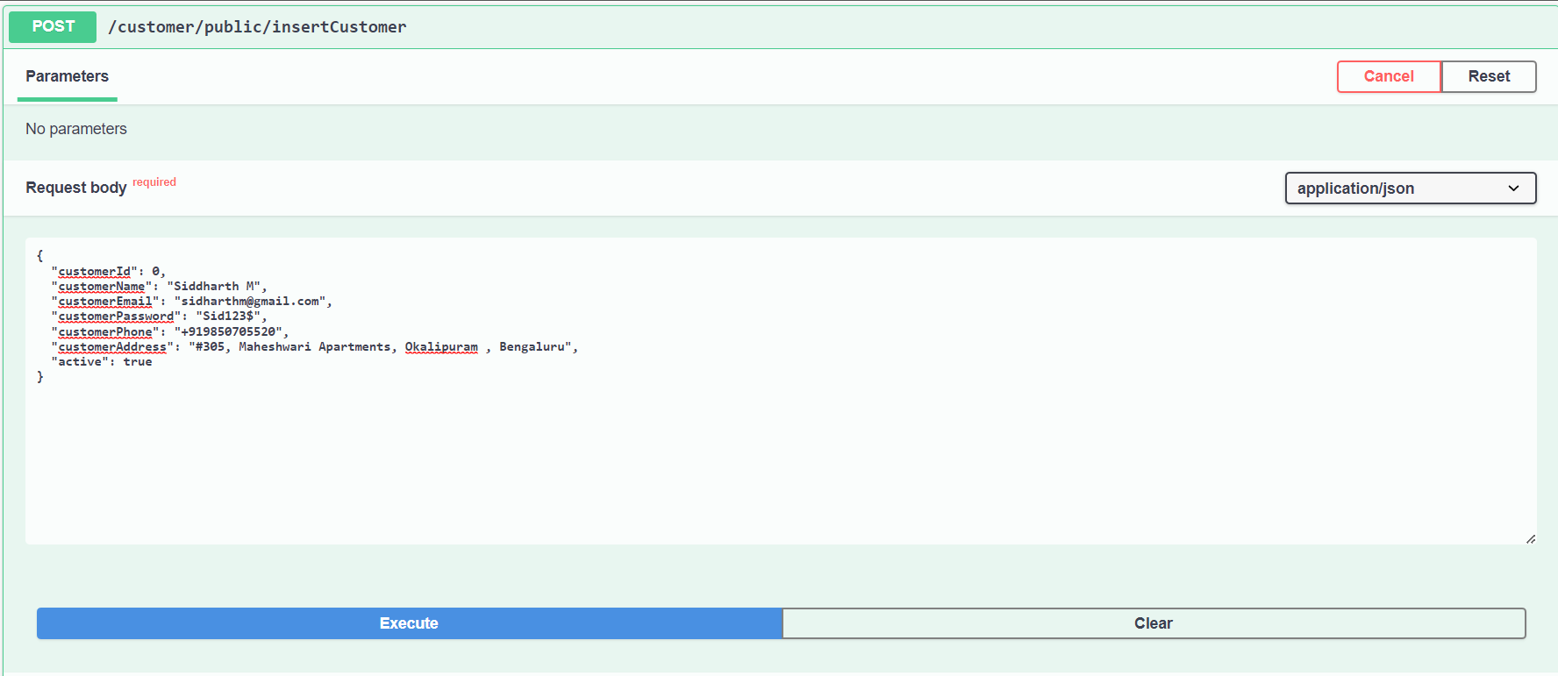
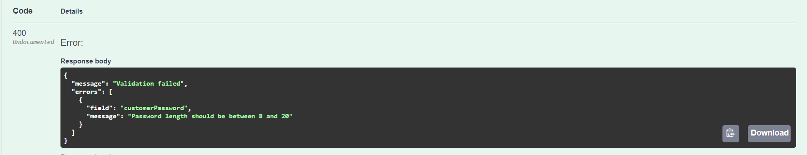
Working of application:
Registering users with invalid credentials.
-validation Example

Slide 14
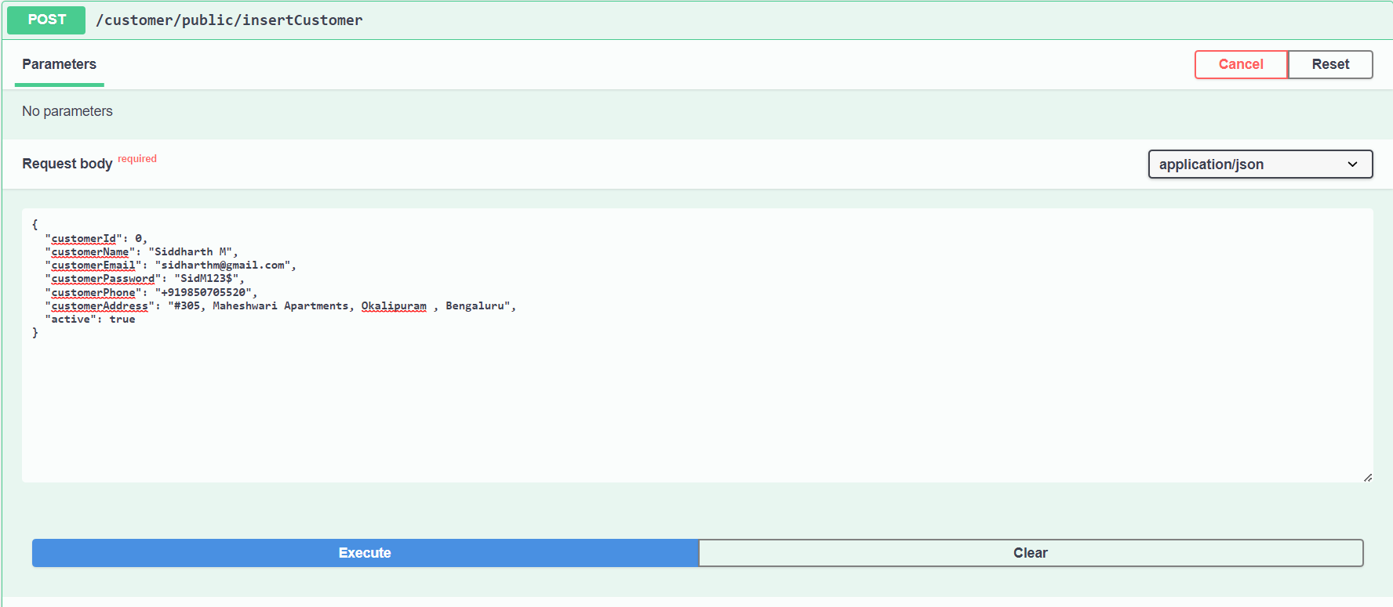
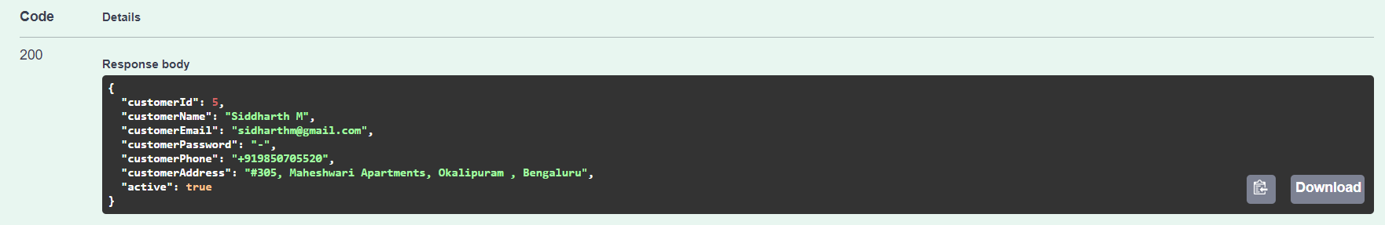
Working of application
Registering user with valid credentials

Slide 15
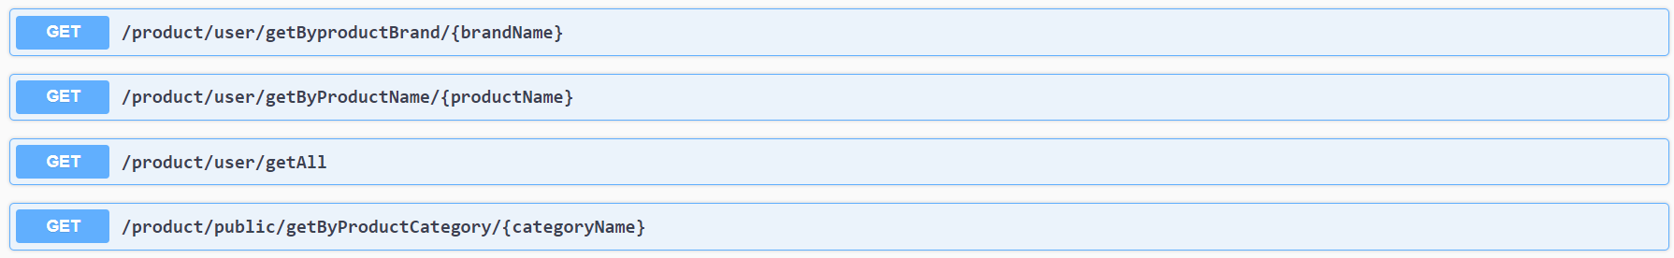
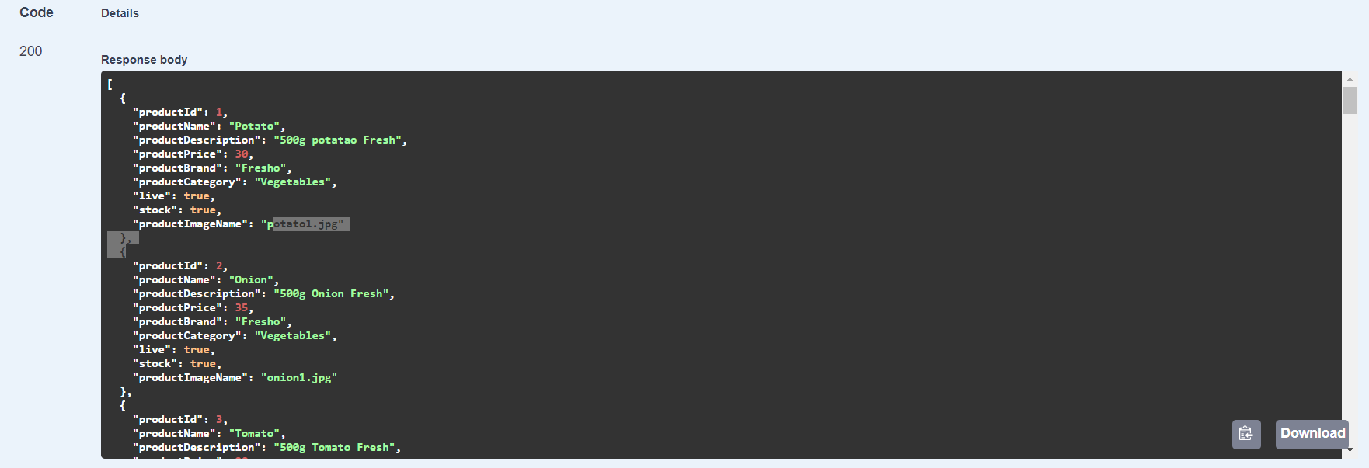
Working of Application
Searching products

Slide 16
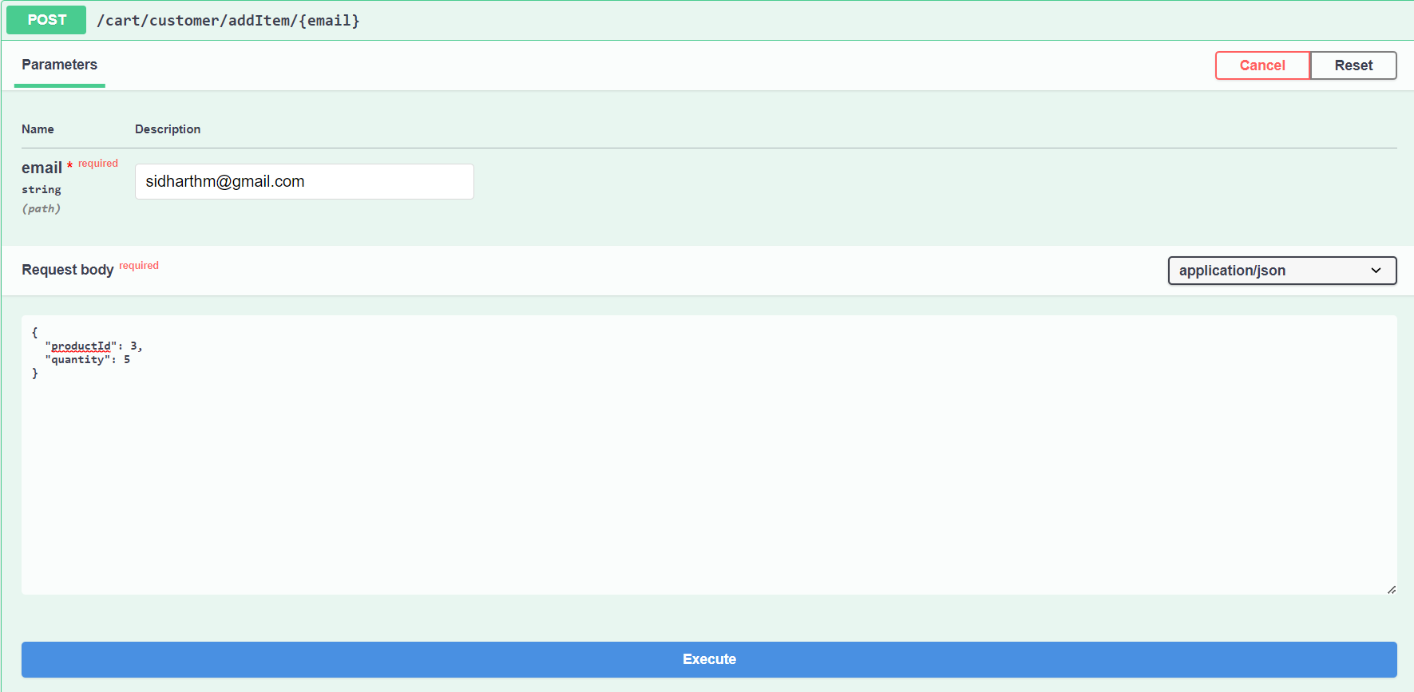
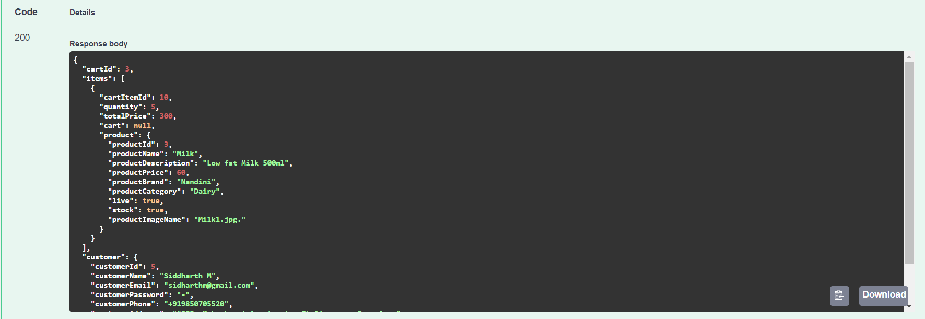
Working of application
Adding Items to the cart

Slide 17
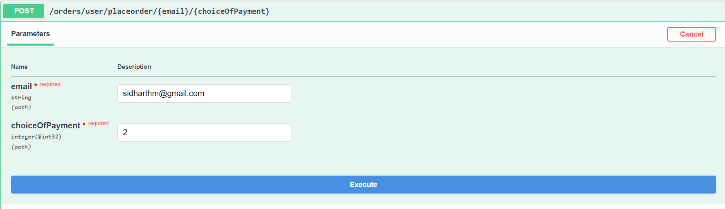
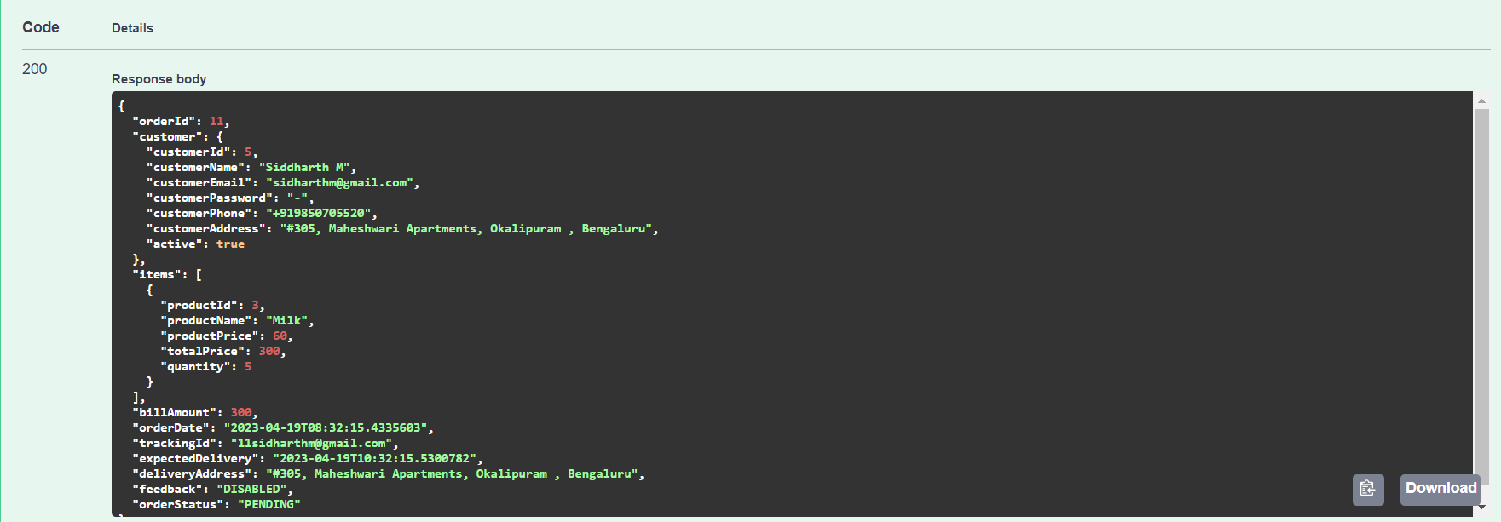
Working of application
Placing Order

Slide 18
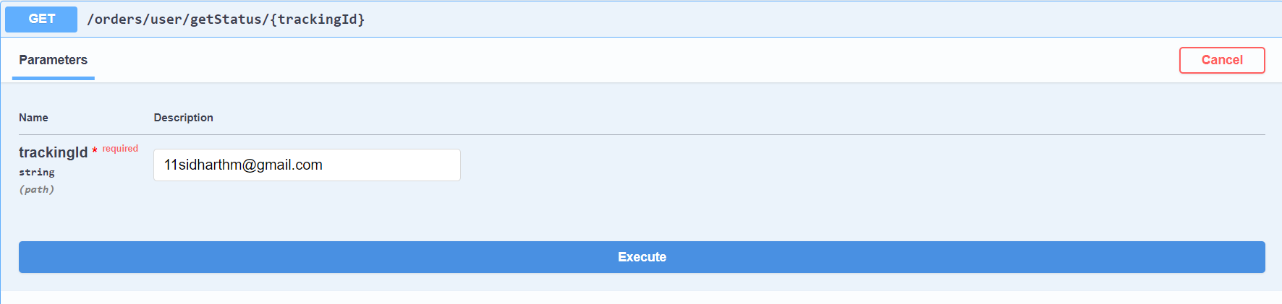
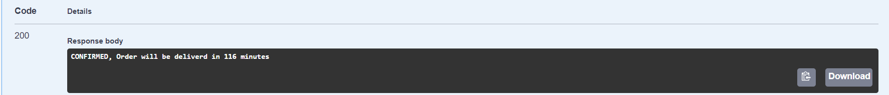
Working Of application
Tracking Order

Slide 19
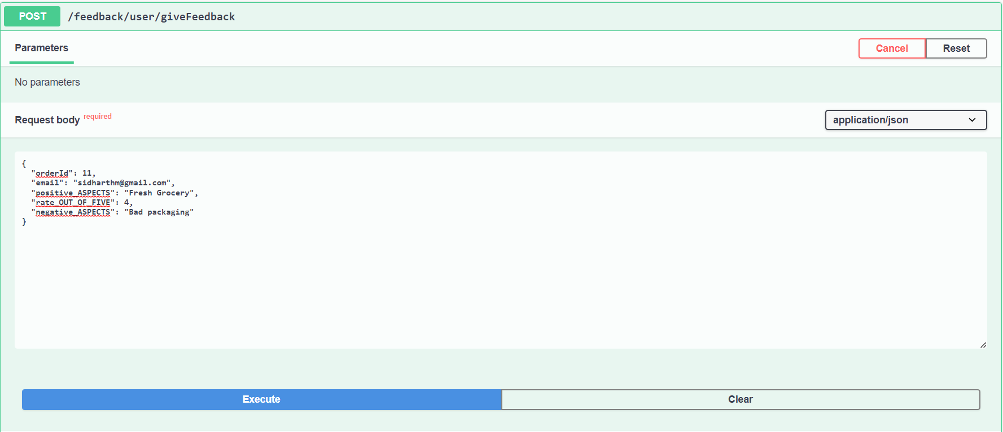
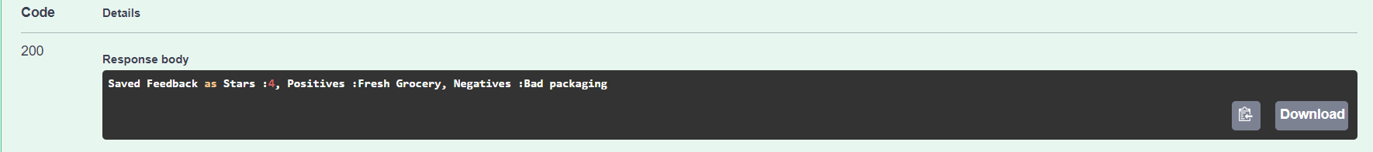
Working of application
Giving Feedback

Slide 20
Conclusion
The online Grocery Delivery application is an essential requirement for customers to order groceries online easily and efficiently.
The implementation ensures that the customers can order the grocery with just few clicks.

